Slide 1
Food Oasis/Saver
Hyper-Hex
Project Manager: Stephen Gilbert
Scrum Master: Mike Fanor
Senior Programmer: Daniel Green
Junior Programmer: Paulyn Monasterio
QA: Minhaj Shujauddin

Slide 2
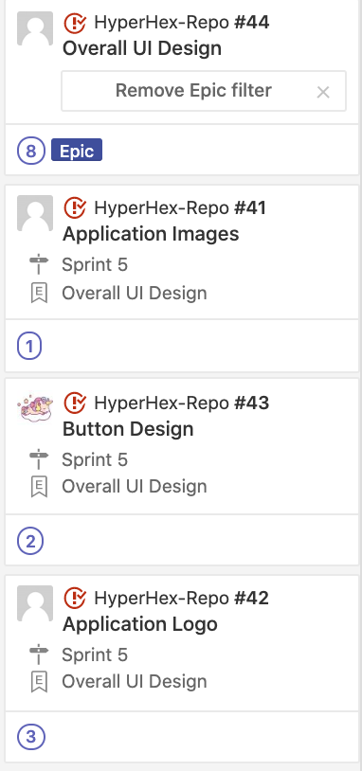
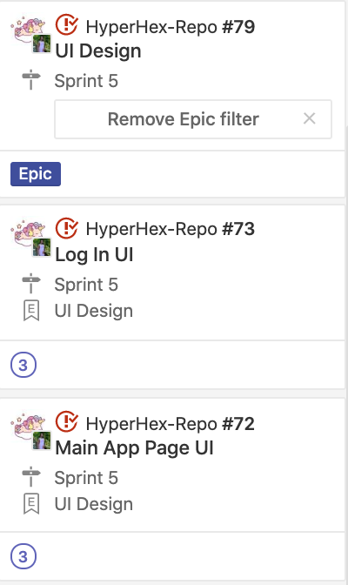
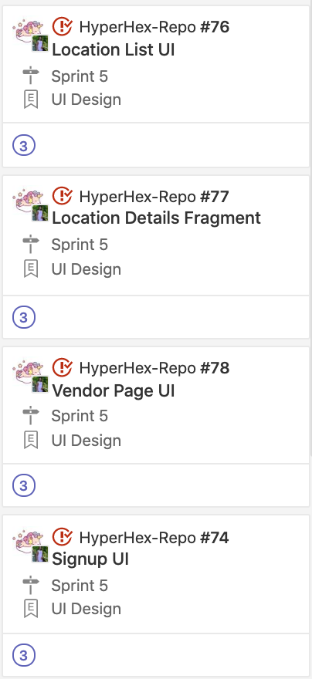
Zenhub
Notes:
We had a ton of issues for this final sprint, and these are just a few.
We were able to get most of them done.

Slide 3
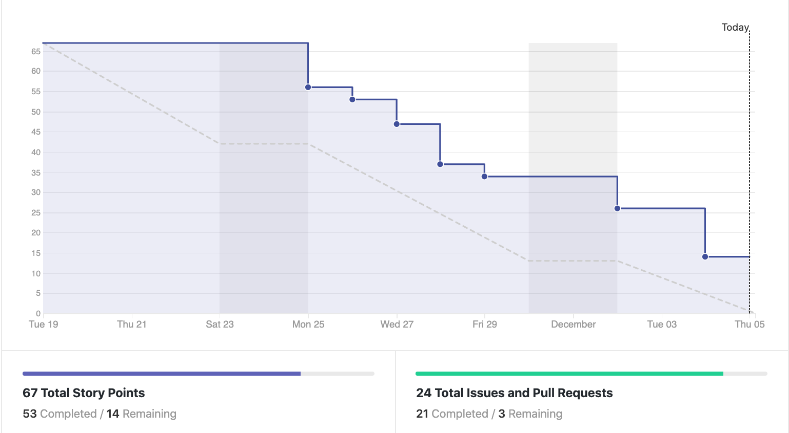
Burndown Chart

Slide 4
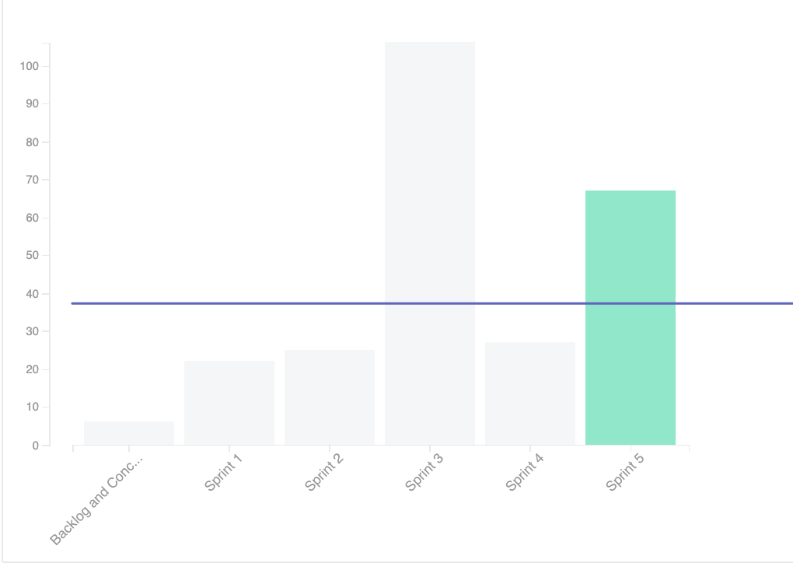
Velocity Chart

Slide 5
Goal - Value Provided
Increase awareness of local healthy food sources.
Provide access to those most in need.
Increase outreach of small businesses and charities.

Slide 6
Target Audience
People living in food deserts and food swamps.
Local food providers and charities.
We want to connect the two.

Slide 7
Comparing to Competition
We are so much better it’s actually painful.

Slide 8
Comparing to Competition
More specifically, our competition is local to Georgia and hosted through Facebook.
Too narrow in scope
Horrible platform
Privacy concerns
Too much baggage.

Slide 9
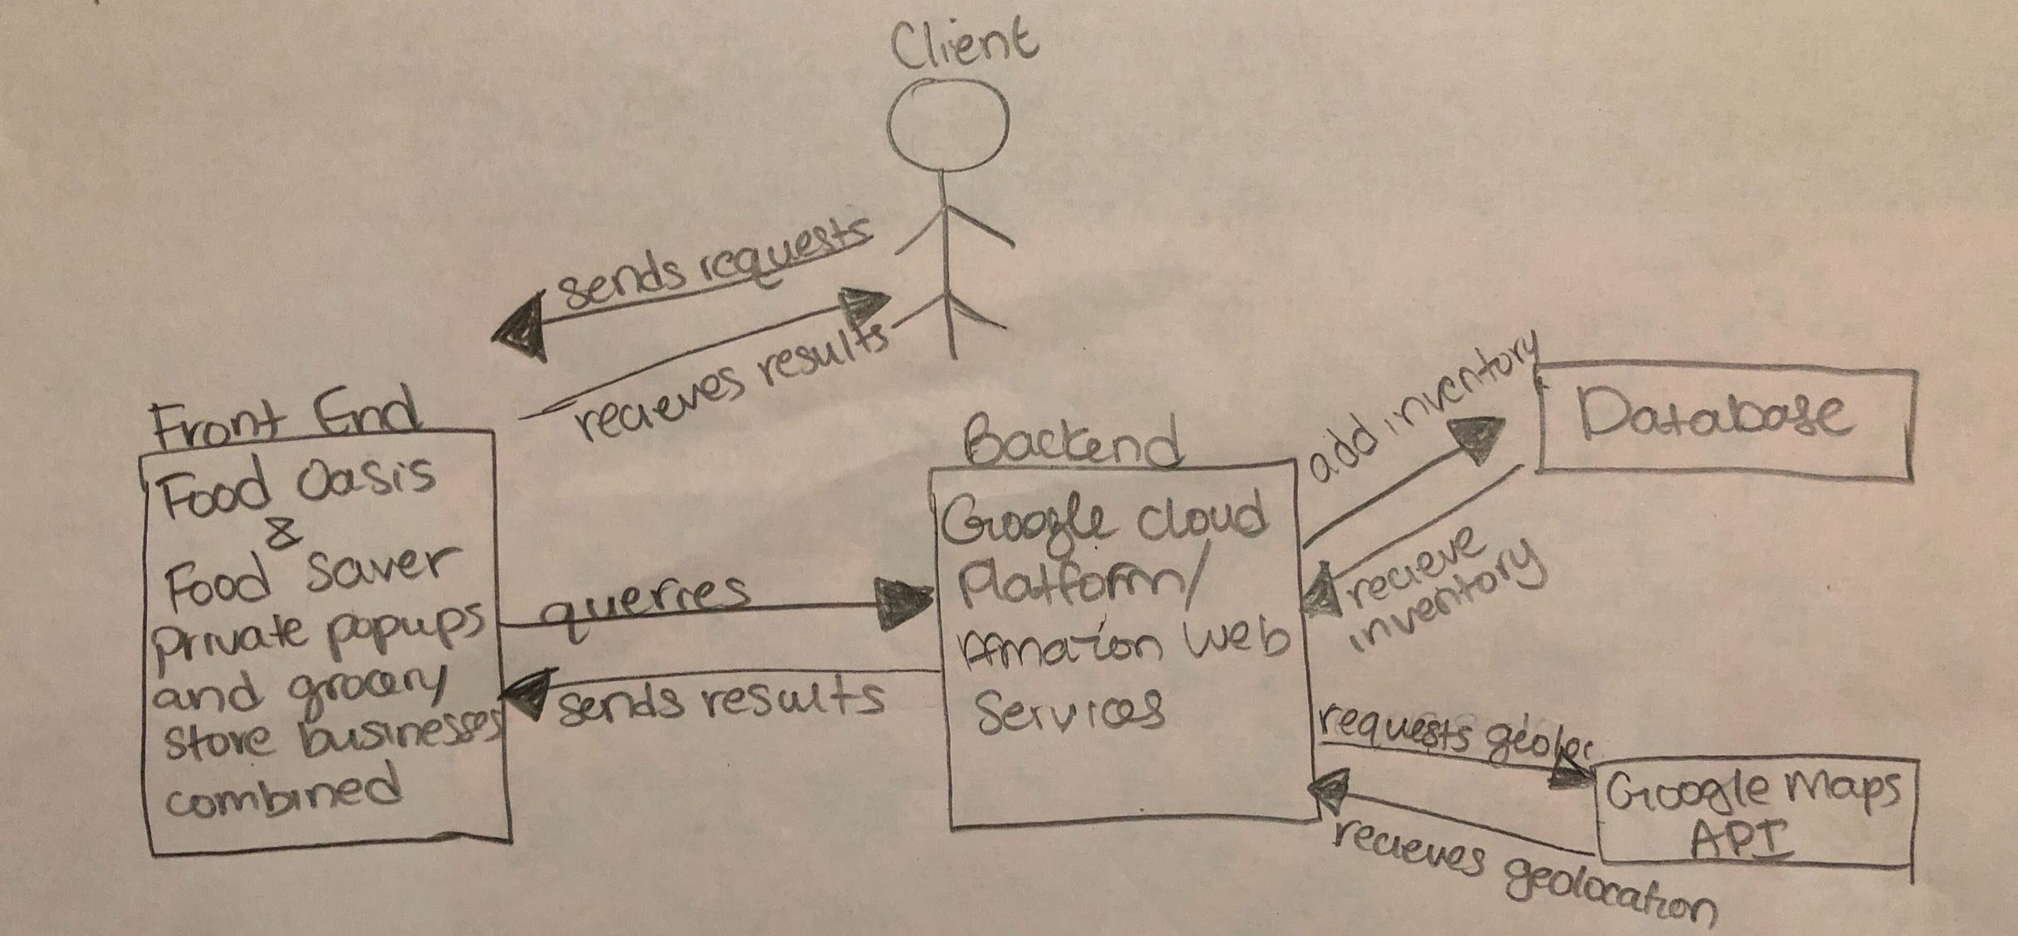
Original Concept Model

Slide 10
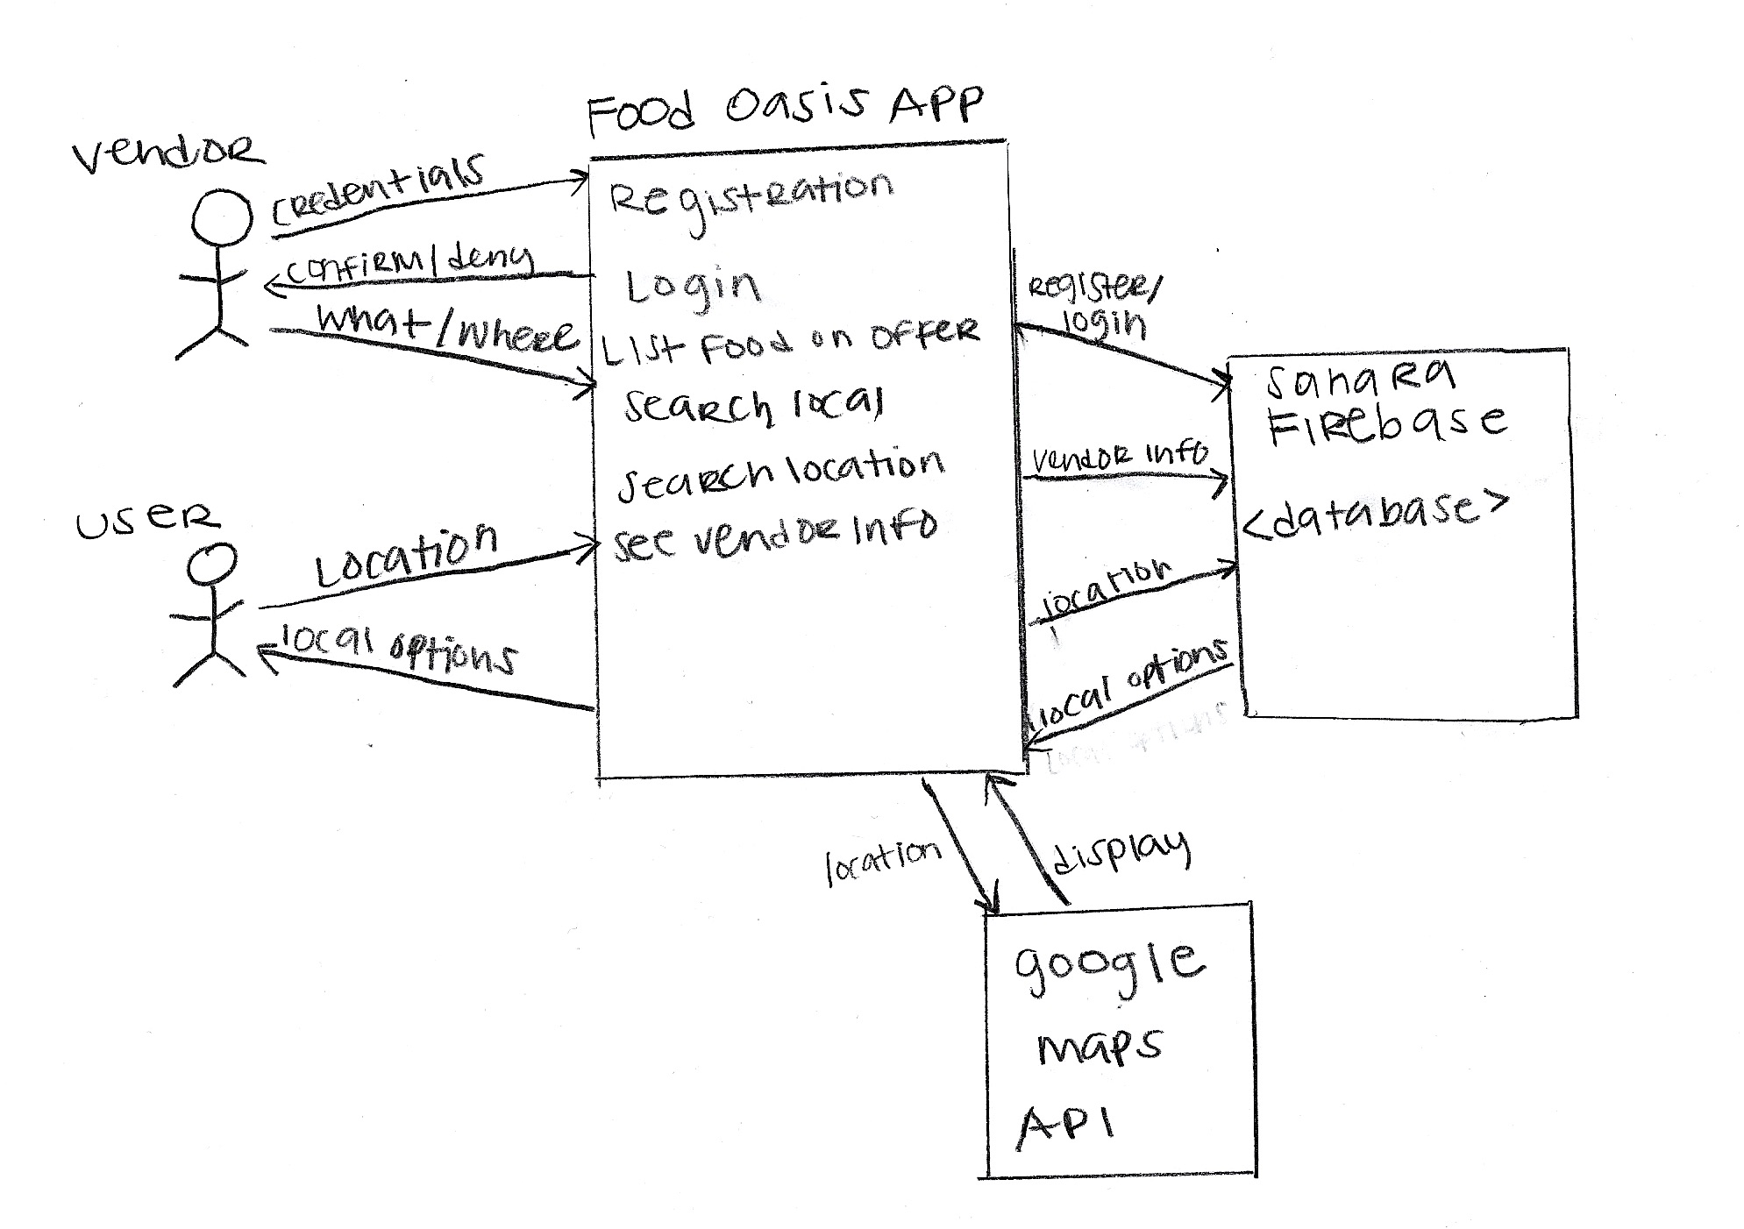
New Product Model

Slide 11
Changes and Divergences
Our original plan turned out broadly correct.
We were only working on the front end
Split in two segments: vendors and users
Both interact with same data, different ways.
This wasn’t without issues
Primarily communication of requirements
Sahara’s Firebase is our database

Slide 12


Database
Web Service

Slide 13
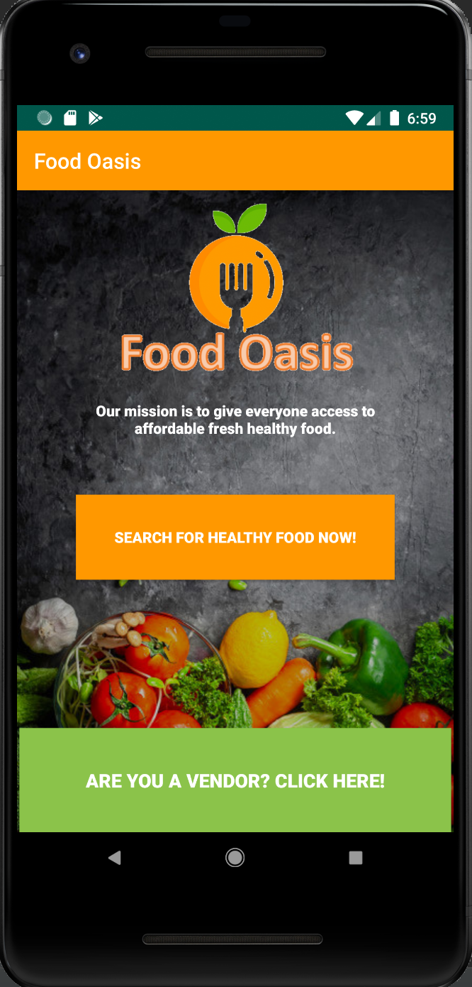
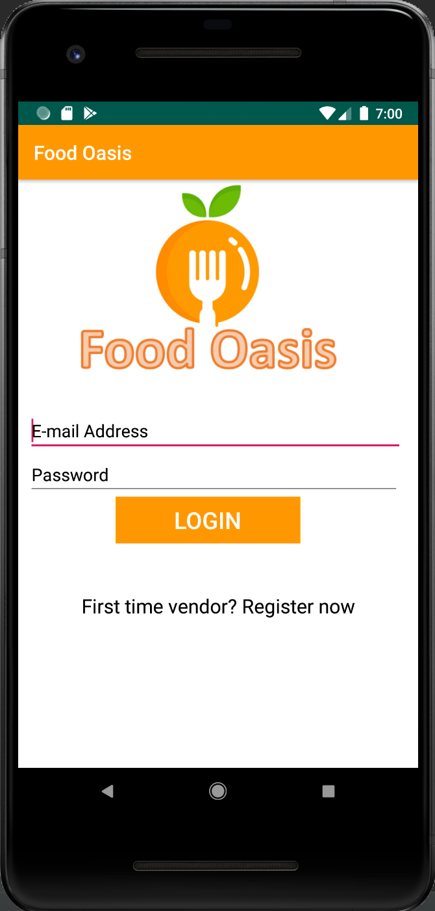
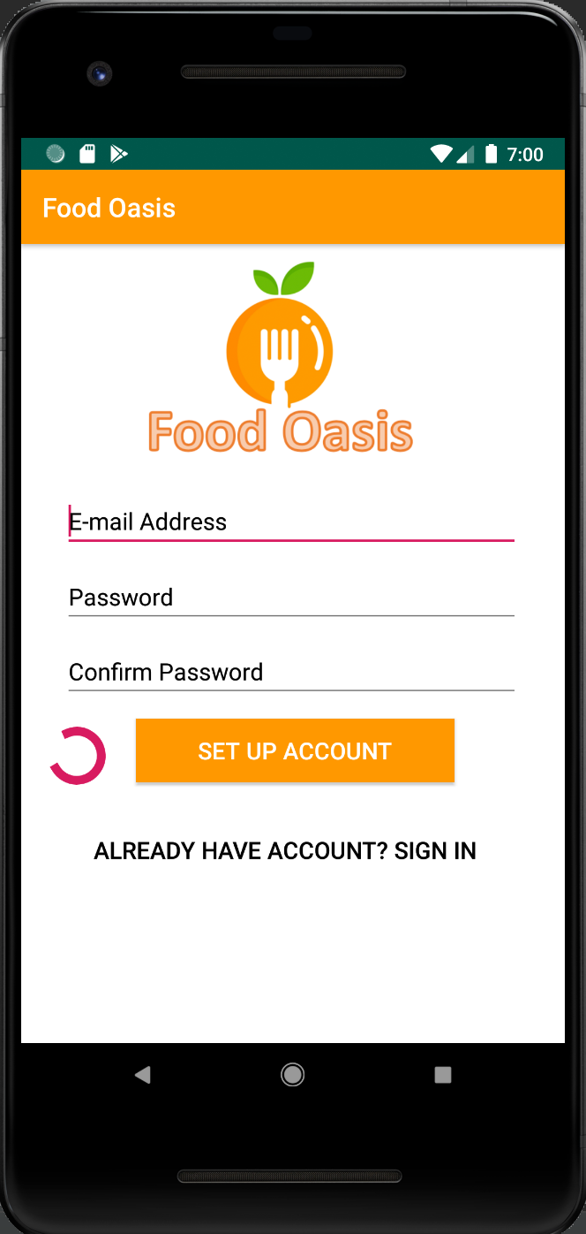
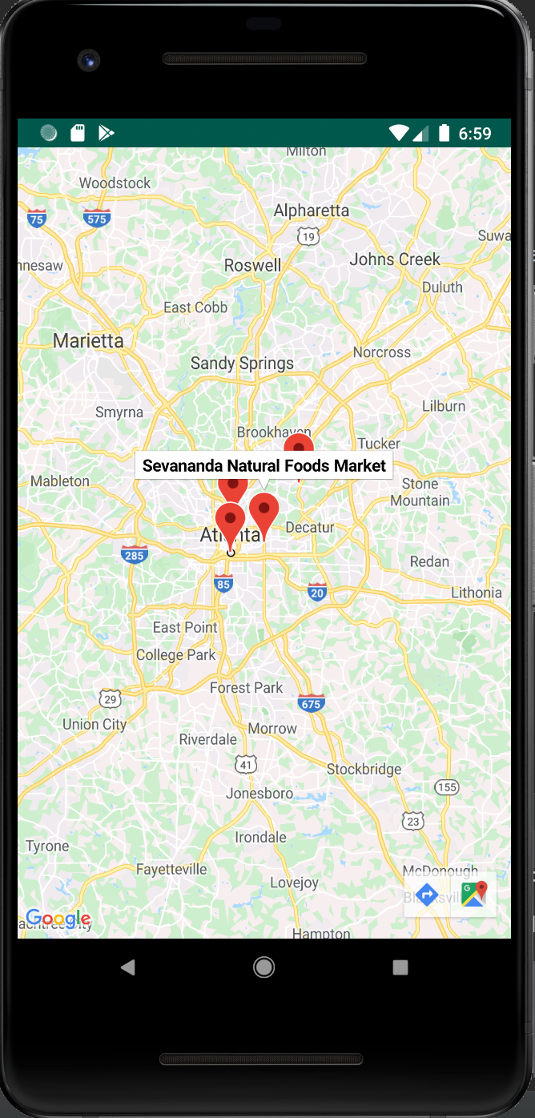
What our product looks like
Notes:
final product
Web services → maps
Data storage → firebase

Slide 14
Product Features
Done
Splash screen
Map integration
Registration/login pages
Vendor dashboard
Not done
Menu bar
Vendor details
Notes:
We don’t have it set up so that users of the app can view vendor details (location and inventory)

Slide 15
Complications
Despite constant communication, issues emerged.
At one point we built the same page three times.
Thought things were ready, but vital pages were undone.
Had to play catch up.

Slide 16
Any questions?

